Slide 1



UNIT 4
LESSON 16
What if…?
Part 1

Slide 2
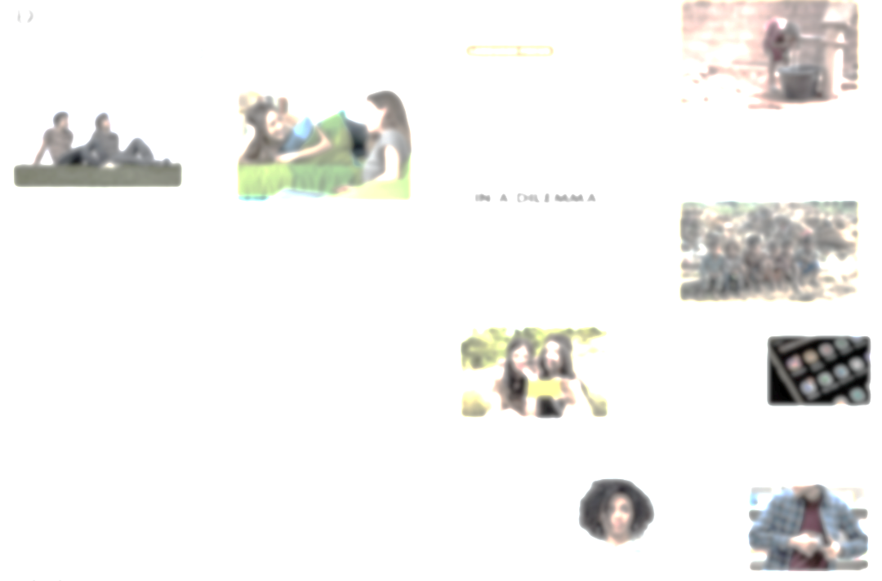
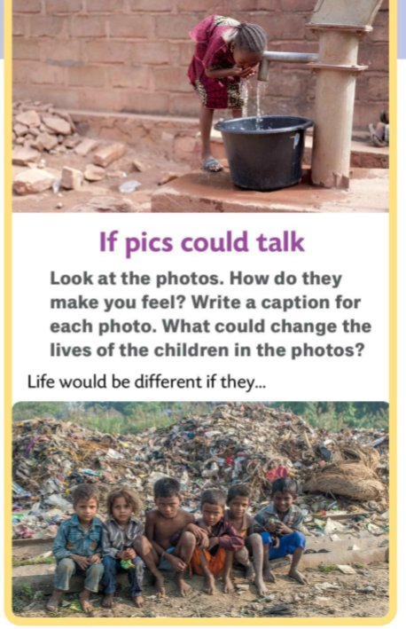
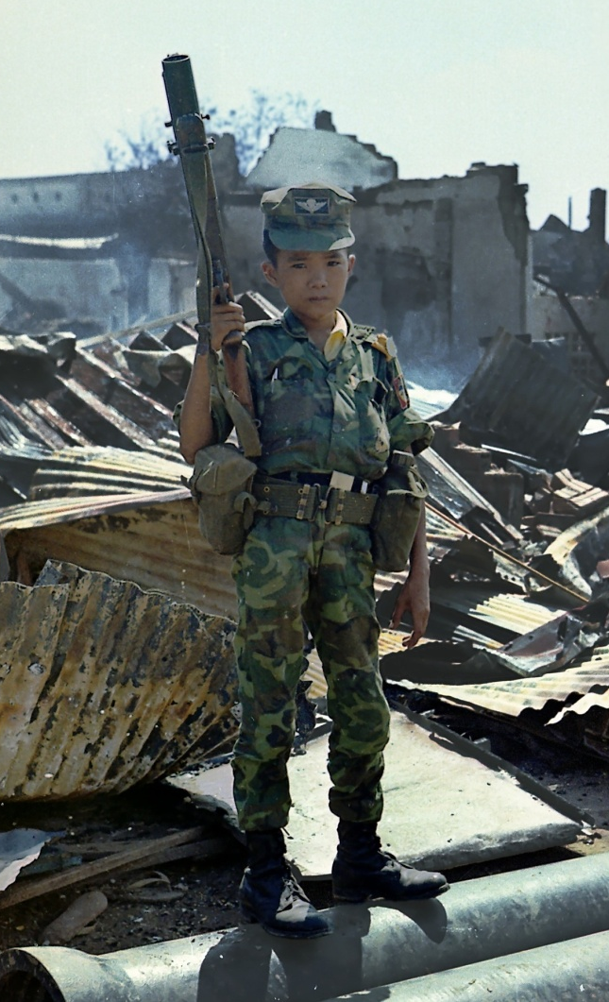
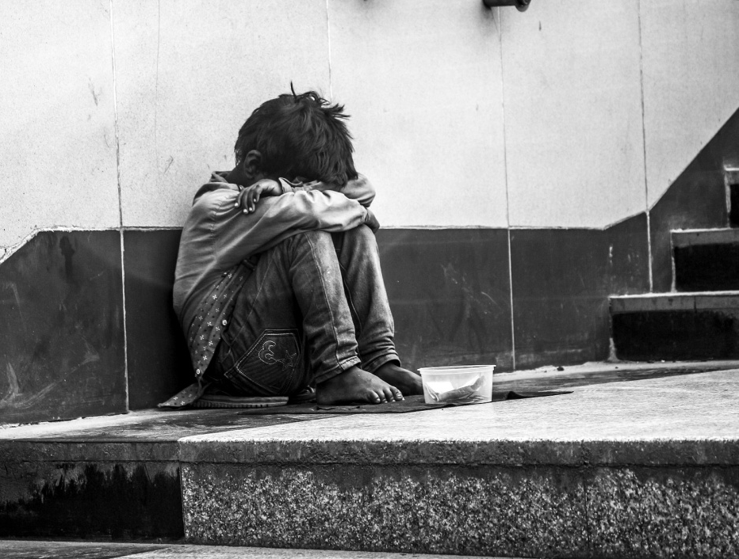
Life would be different if he/she/they had... was/were...

Slide 3
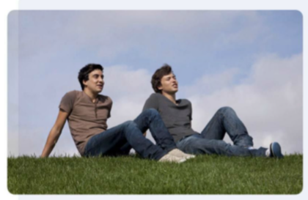
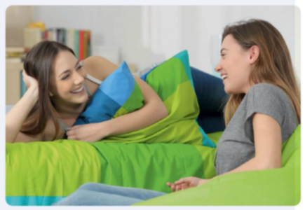

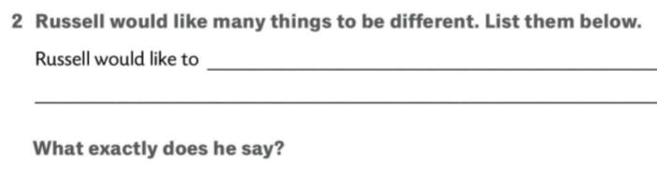
What are Keith and Russell talking about?
What are Nikki and Keiran talking about?
How are they feeling?
What are they saying?

Slide 4
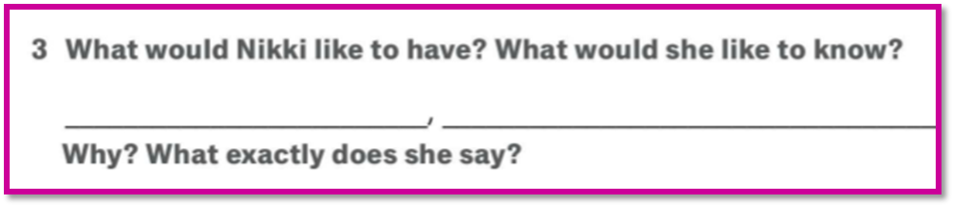
23eeeeeeeeeee45
be older, have longer hair, be in a band, have a motorbike.
If I were older, she would notice me.
If I had longer hair, she would notice me.
If I were in a band, she would notice me.
If I had a motorbike, she would notice me.
If I were top of the class, she would notice me.
his number, have his address; know his number.
If I had his number, I’d call him.
If I had his address, I’d write a letter to him.
If I knew his name, I’d find it in the telephone book.

Slide 5
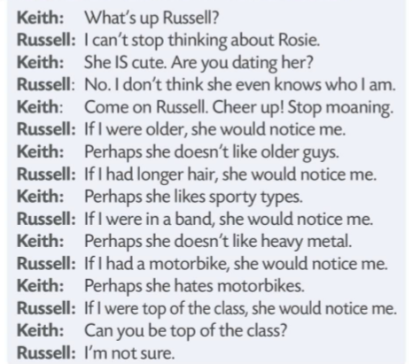
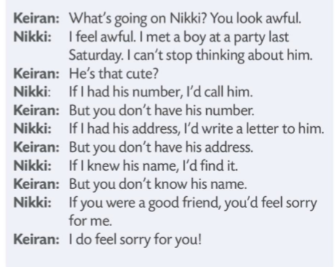
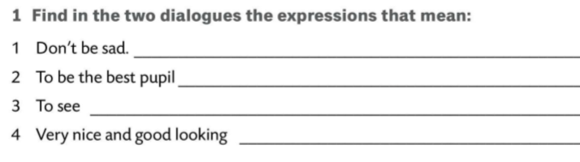
Cheer up. Stop moaning.
to be top of the class
to notice
cute

Slide 6
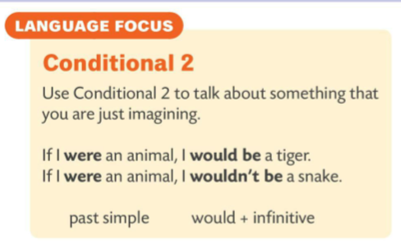

If I were older, she would notice me.
If I had longer hair, she would notice me.
If I had his number, I’d call him.
If I had his address, I’d write a letter to him.
Da sam stariji, ona bi me primijetila.
Da imam dužu kosu, ona bi me primijetila.
Da imam njegov broj, nazvala bih ga.
Da imam njegovu adresu, napisala bi mu pismo.
Sentences have nothing to do with the past. They are used to talk about certain things hypothetically.
Rečenice nisu povezane s prošlošću. Koriste se kako bi se o određenim situacijama razgovaralo hipotetski.

Slide 7
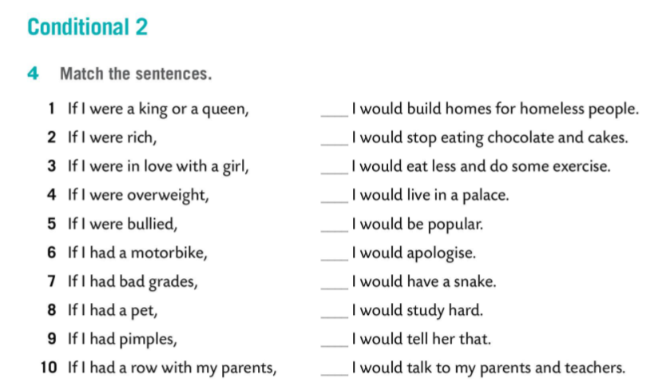
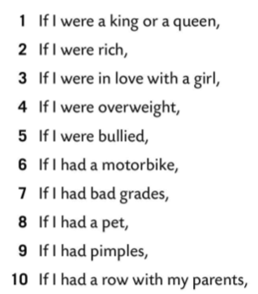
2
9
4
1
6
10
8
7
3
5

